Slide 1
SAHAR MAHER

Slide 2
NLP with LTSM & RNN

Slide 3
AGENDA
Preparing Data
MODEL FUNCTION
RNN MODEL
LSTM MODEL

Slide 4
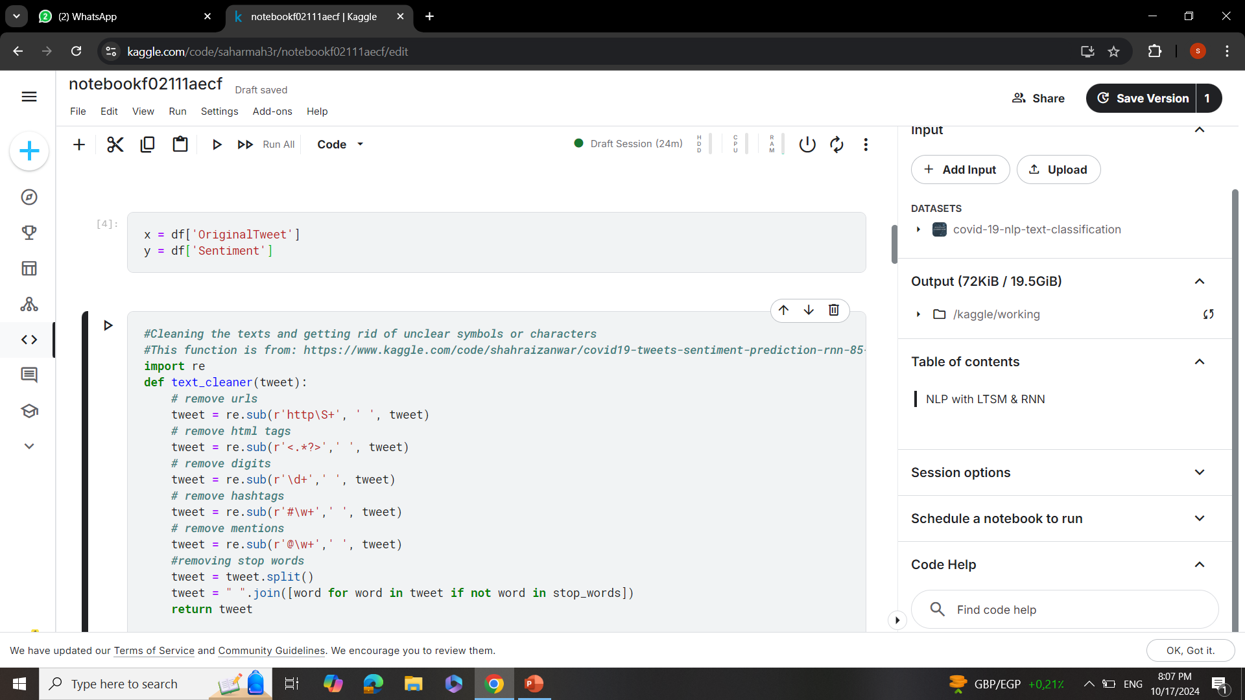
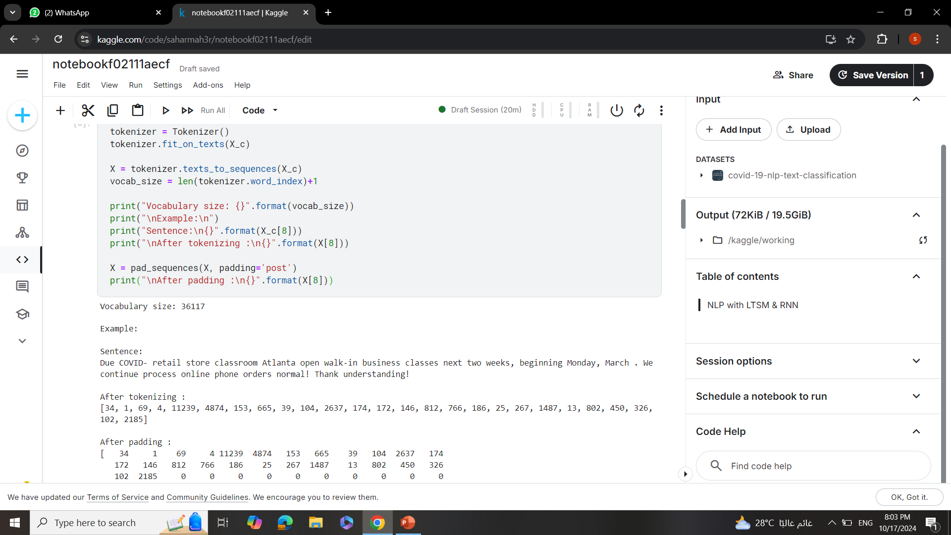
Preparing Data

Slide 5
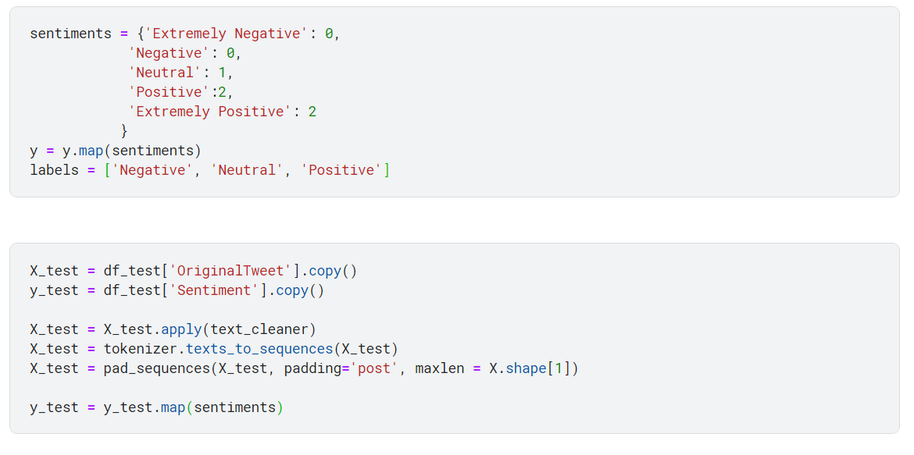
Preparing Data

Slide 6
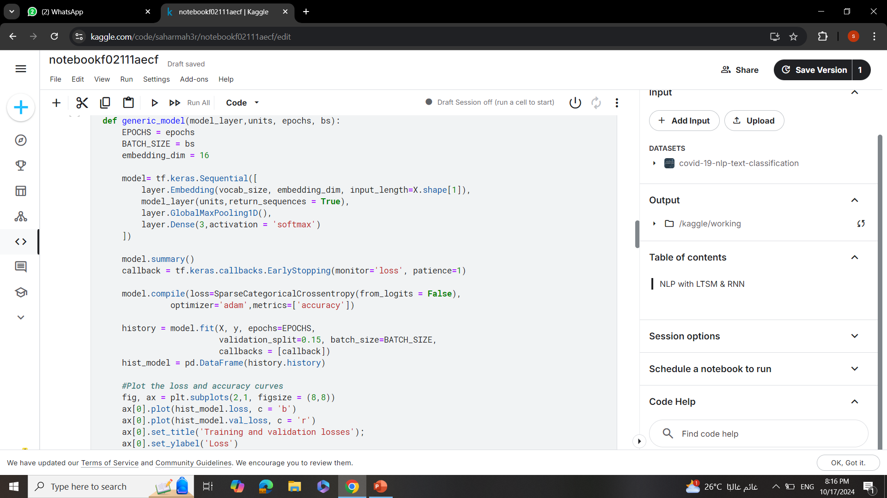
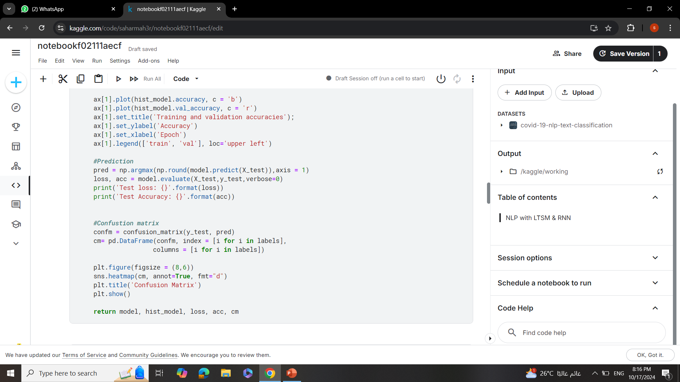
MODEL FUNCTION
.
.

Slide 7
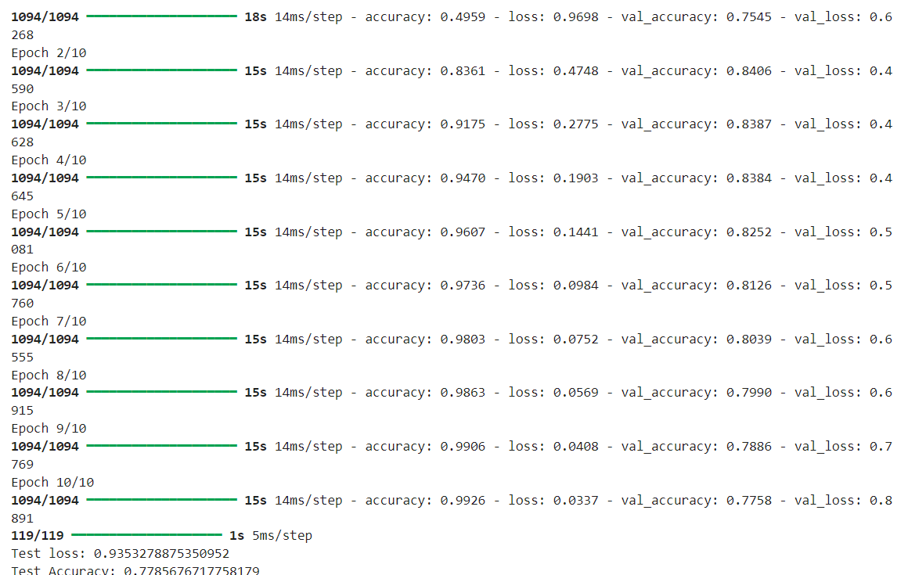
RNN MODEL
.
I used 10 epochs
And batch size = 32
With test loss of 0.9353
And test accuracy of
0.7785

Slide 8
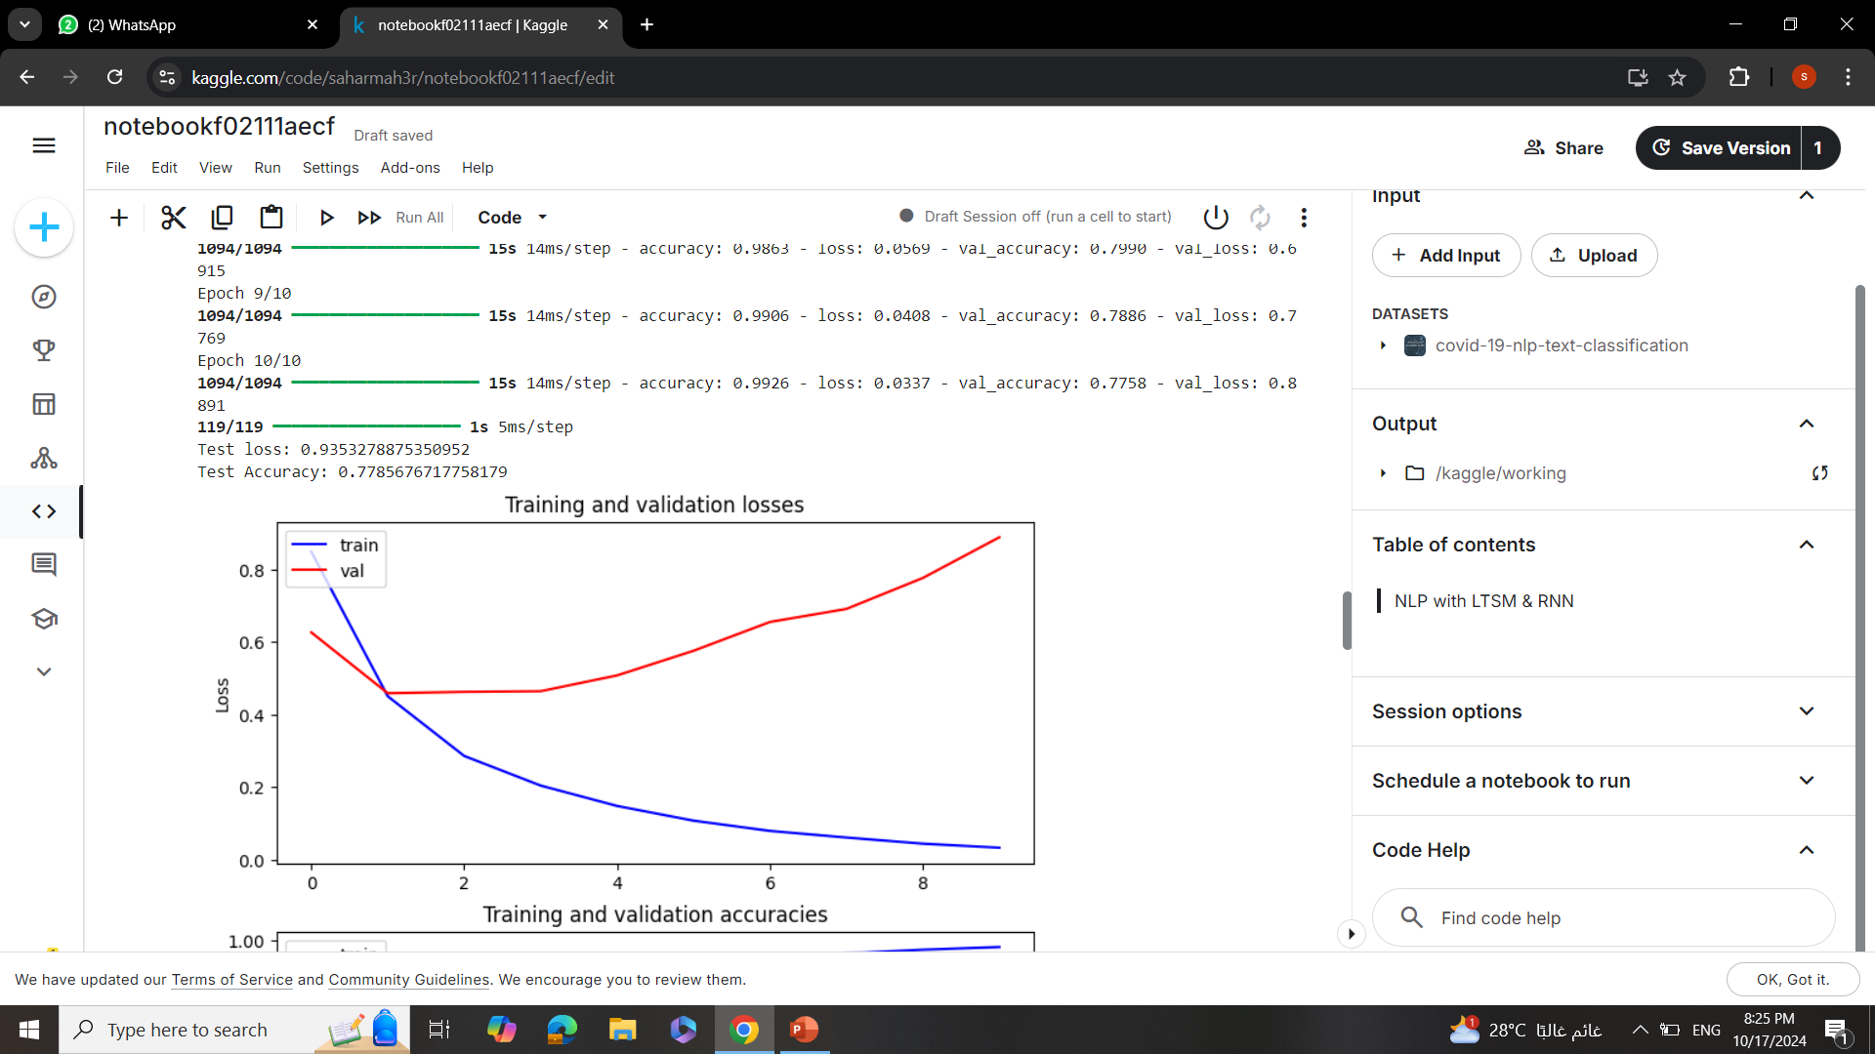
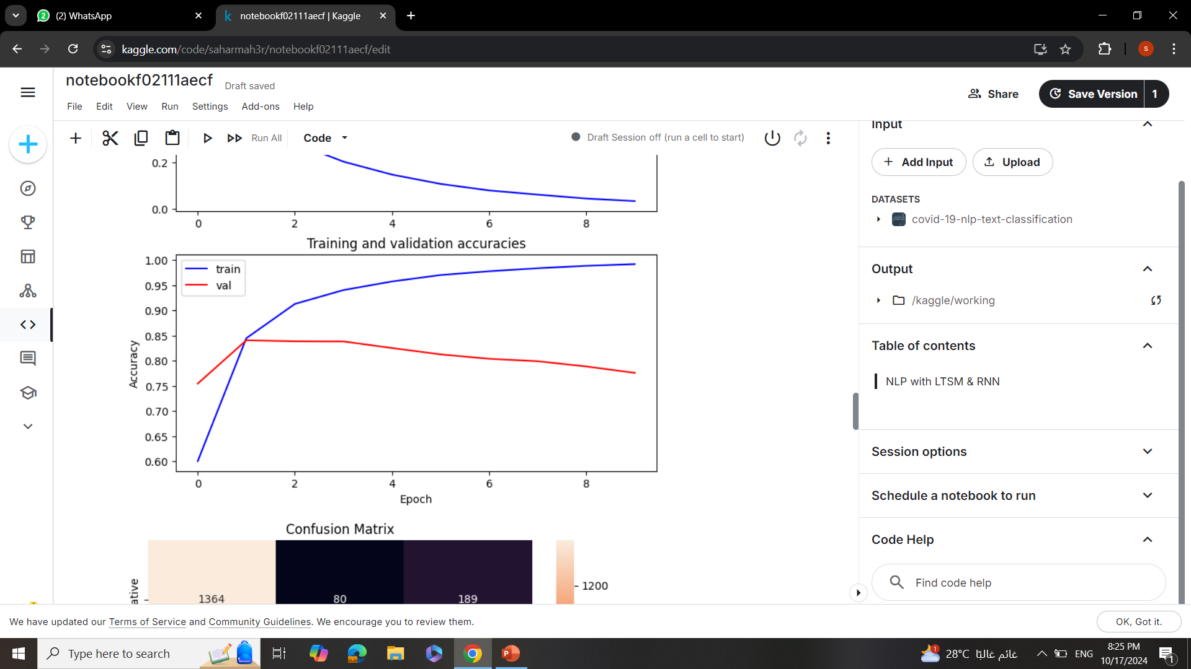
RNN
.
.

Slide 9
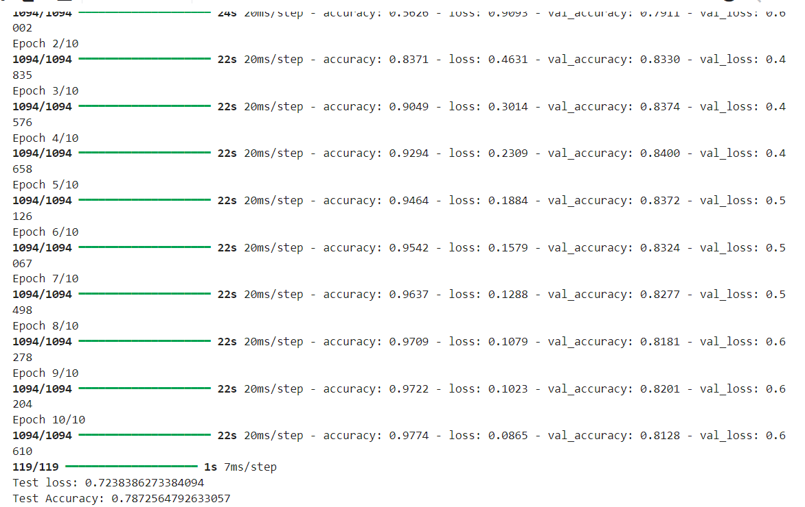
LSTM MODEL
.
I used 10 epochs
And batch size = 32
With test loss of 0.7238
And test accuracy of
0.7872

Slide 10
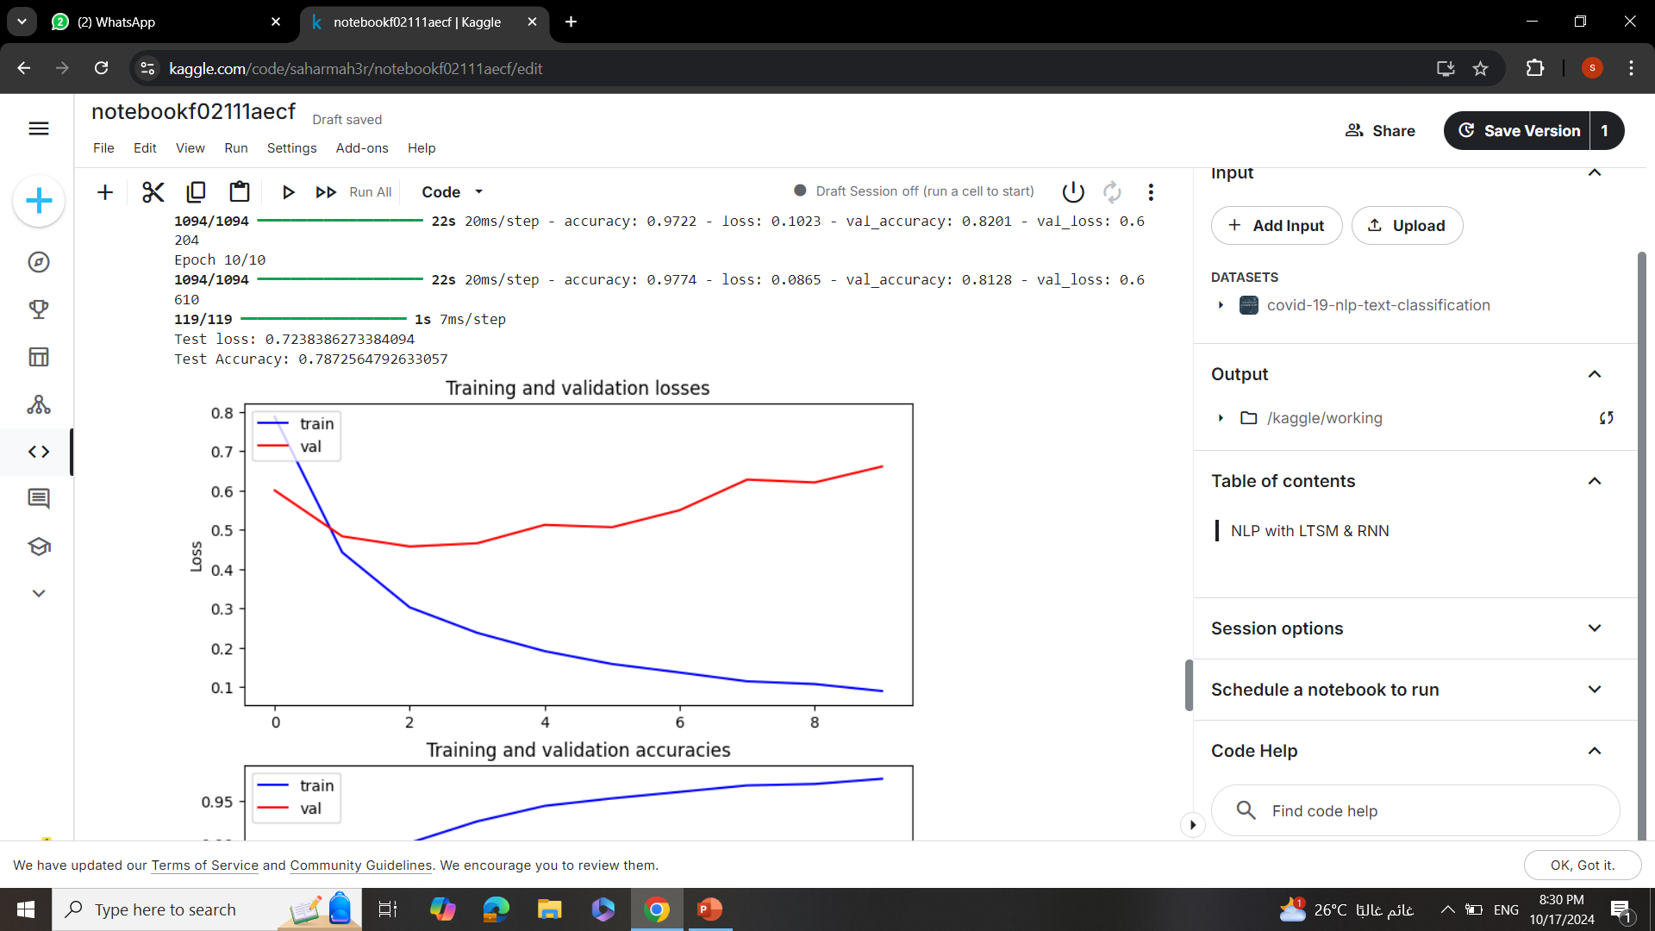
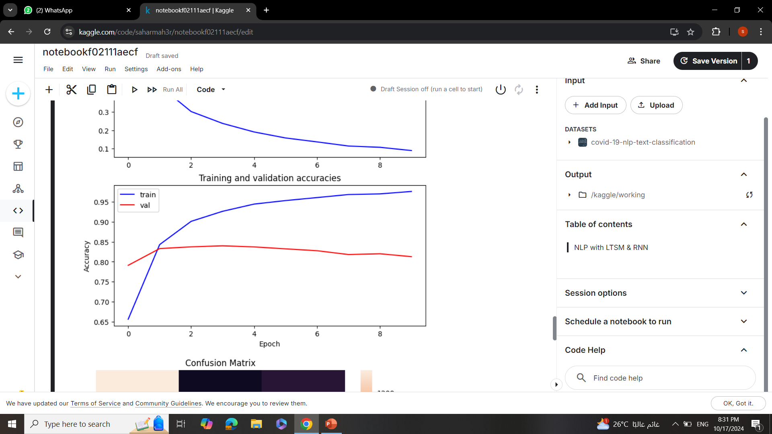
LSTM
.
.

Slide 11
Sherine TArek

Slide 12
NLP With Transformers [BERT]

Slide 13
Agenda
Prepare Data
Training
Prediction
Accuracy for every epoch
Confusion Matrix

Slide 14
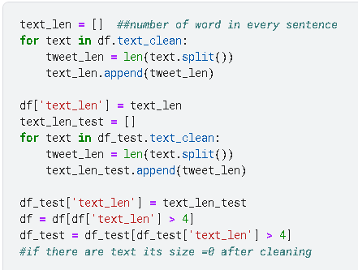
Prepare DATA

Slide 15
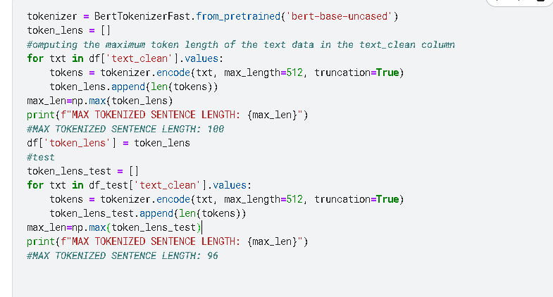
Prepare Data

Slide 16
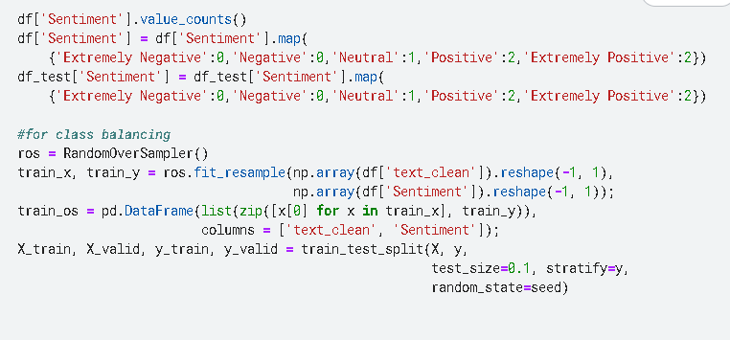
Splitting

Slide 17
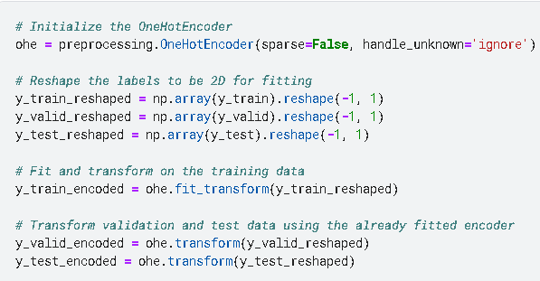
One Hot Encoding

Slide 18
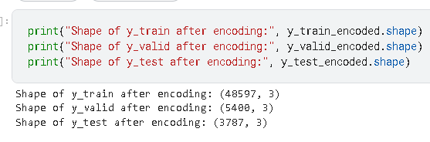
DAta after One Hot Encoding

Slide 19
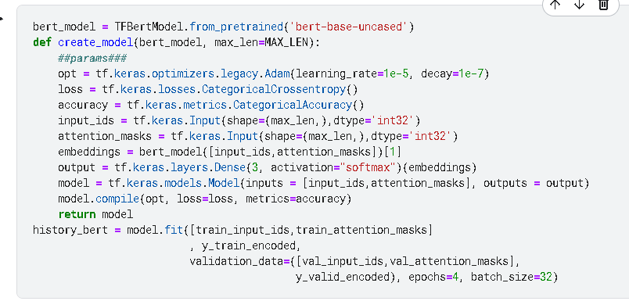
Model Functions

Slide 20
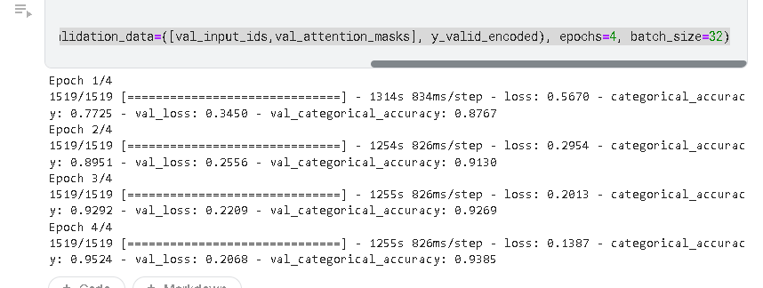
Accuracy for every epoch

Slide 21
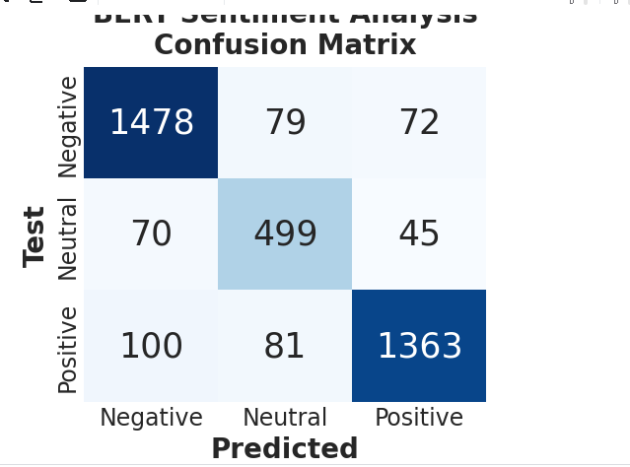
Confusion matrix

Slide 22
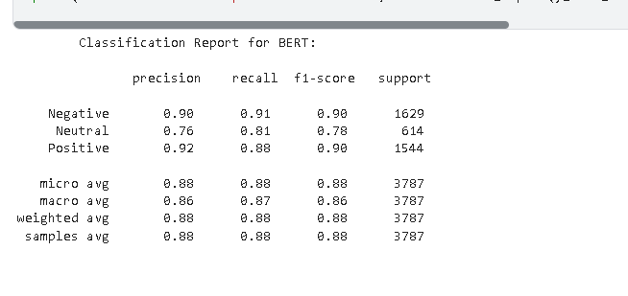
Model REport

